Slide 1
Computing Technology

Slide 2
Computing Technology🏈
No break today, cupcakes at end! 🧁
Submit cs50.ly/form before class starts!
Do say bye or ask questions (or ask for stress ball 🔴) after class!
(Took out winter decorations a bit early.)

Slide 3
Computing Technology

Slide 4

Notes:
https://youtube.com/watch?v=Tj84DzF6_v4
https://www.dropbox.com/scl/fi/7be9cwnj707ksasbnek57/muppet_hackathon-1080p.mp4?rlkey=mc6r5w75bqm4il7g1zdr3wm8o&dl=0

Slide 5

Notes:
https://emojipedia.org/cupcake/

Slide 6
Computing Technology

Slide 7
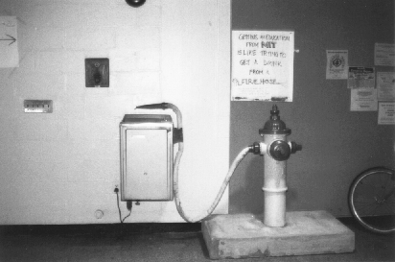
Notes:
http://hacks.mit.edu/Hacks/by_year/1991/fire_hydrant/

Slide 8
what ultimately matters in this course is not so much where you end up relative to your classmates but where
you end up relative to yourself when you began

Slide 9
input →
→ output
Notes:
before process, have to represent information

Slide 10
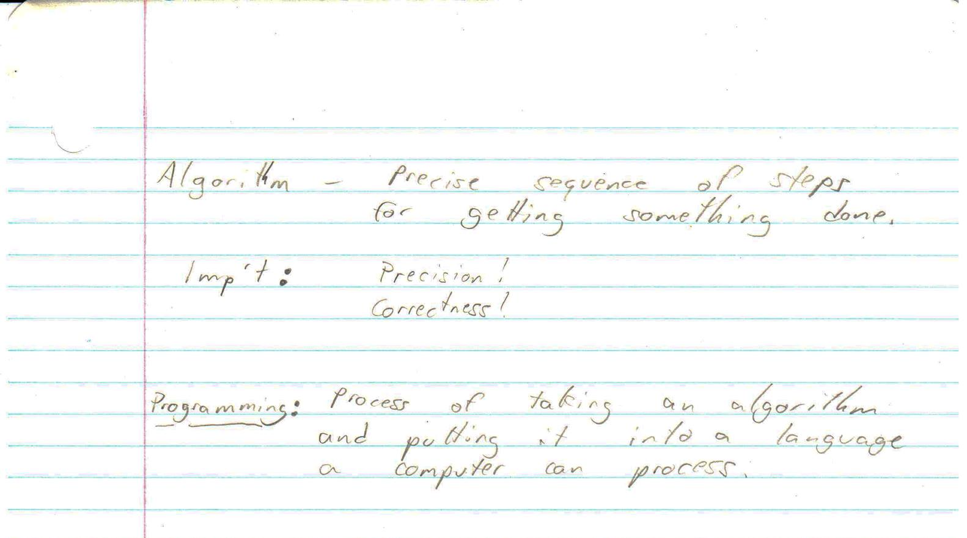

Slide 14
Final Project

Slide 15
all that we ask is that you build something of interest to you, that you solve an actual problem, that you impact campus, or that you change the world

Slide 16
strive to create something that outlives this course

Slide 17
Computing Technology Hackathon

Slide 18
Visual Studio Code for CS50
code.visualstudio.com

Slide 19
Install command-line tools
https://developer.apple.com/xcode/ https://learn.microsoft.com/en-us/windows/wsl/about ...

Slide 20
Learn Git
https://youtu.be/MJUJ4wbFm_A ...

Slide 21
Host a website
https://pages.github.com/ https://www.netlify.com/ ...

Slide 22
Host a web app
https://aws.amazon.com/education/awseducate/ https://azure.microsoft.com/en-us/free/students/ https://cloud.google.com/edu/students https://education.github.com/pack https://www.heroku.com/ https://vercel.com/ ...

Slide 23
Ask questions
https://chatgpt.com/ https://github.com/features/copilot ...

Slide 24
Ask questions
https://www.reddit.com/r/learnprogramming/ https://www.reddit.com/r/programming/ https://stackoverflow.com/ https://serverfault.com/ …

Slide 25
Read news
https://techcrunch.com/ https://news.ycombinator.com/ ...

Slide 26
Take classes
https://cs50.edx.org/python https://cs50.edx.org/r https://cs50.edx.org/web https://cs50.edx.org/games https://cs50.edx.org/ai https://cs50.edx.org/sql https://cs50.edx.org/cybersecurity …

Slide 27
Thank you

Slide 28


Slide 29


cs50.ly/poll
Notes:
https://emojipedia.org/apple/ios-17.4/selfie

Slide 30
Computing Technology

Slide 31
Notes:
https://emojipedia.org/cupcake/

Slide 32
Computing Technology

